Slide 1
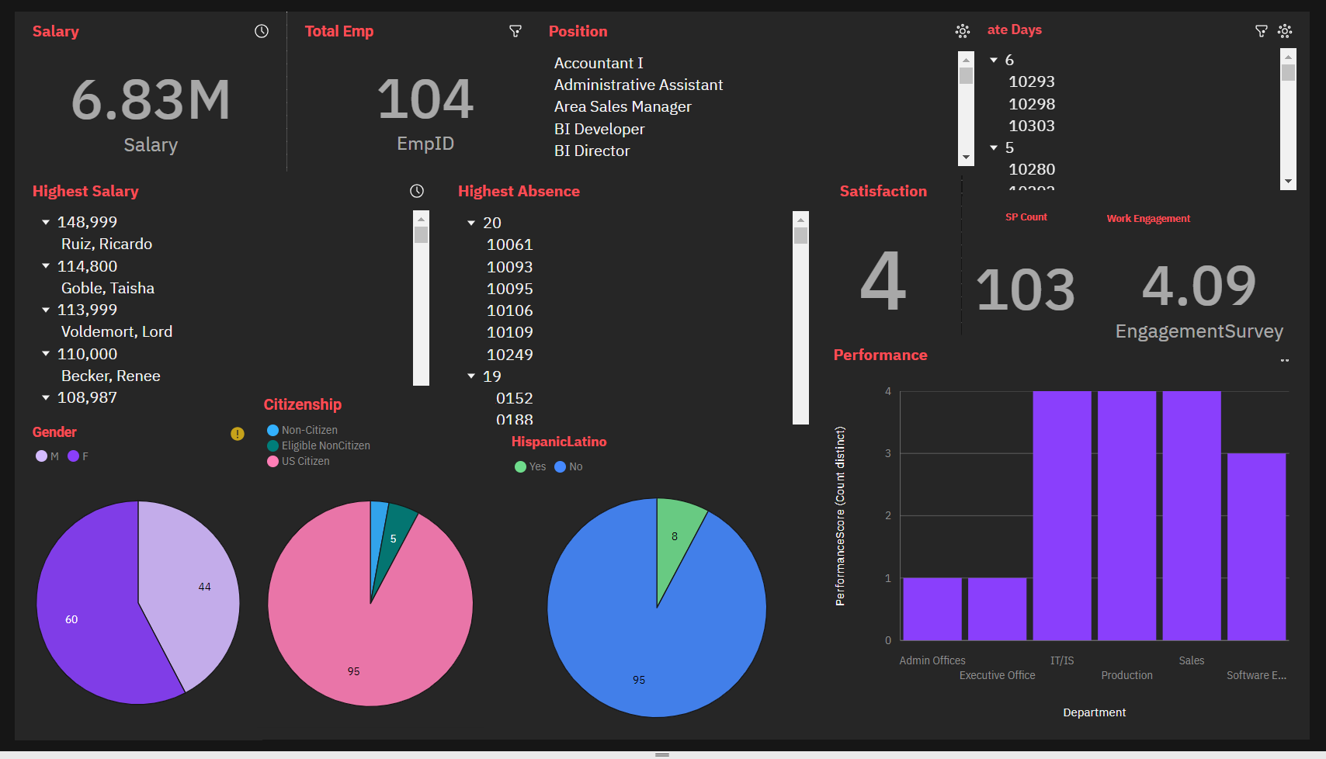
NAME | CAROLINE SUSANNA S
REG NO | 311520104013
TEAM ID | NM2023TMID07501
EMAIL ID | carolsankho@gmail.com
 | ASSIGNMENT - 2
Task | Upload the dataset to Cognos Analytics, prepare the data, explore and create Interactive Dashboard, report and Story
Problem Statement:-
HR data can be hard to come by, and HR professionals generally lag behind with respect to analytics and data visualization competency. We use the data set to teach HR students how to use and analyze the data in Cognos - a data visualization tool that's easy to learn.
Output:-
Overall Dashboard

Slide 2
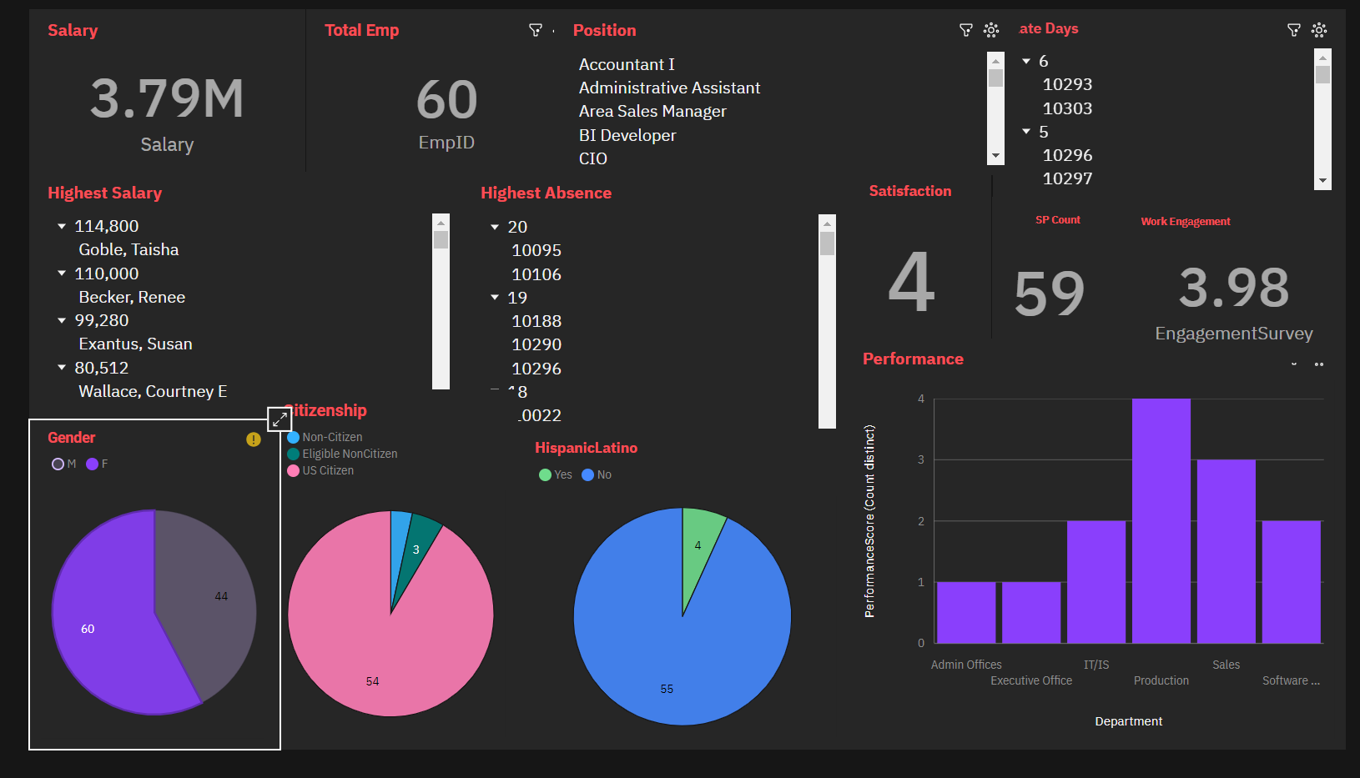
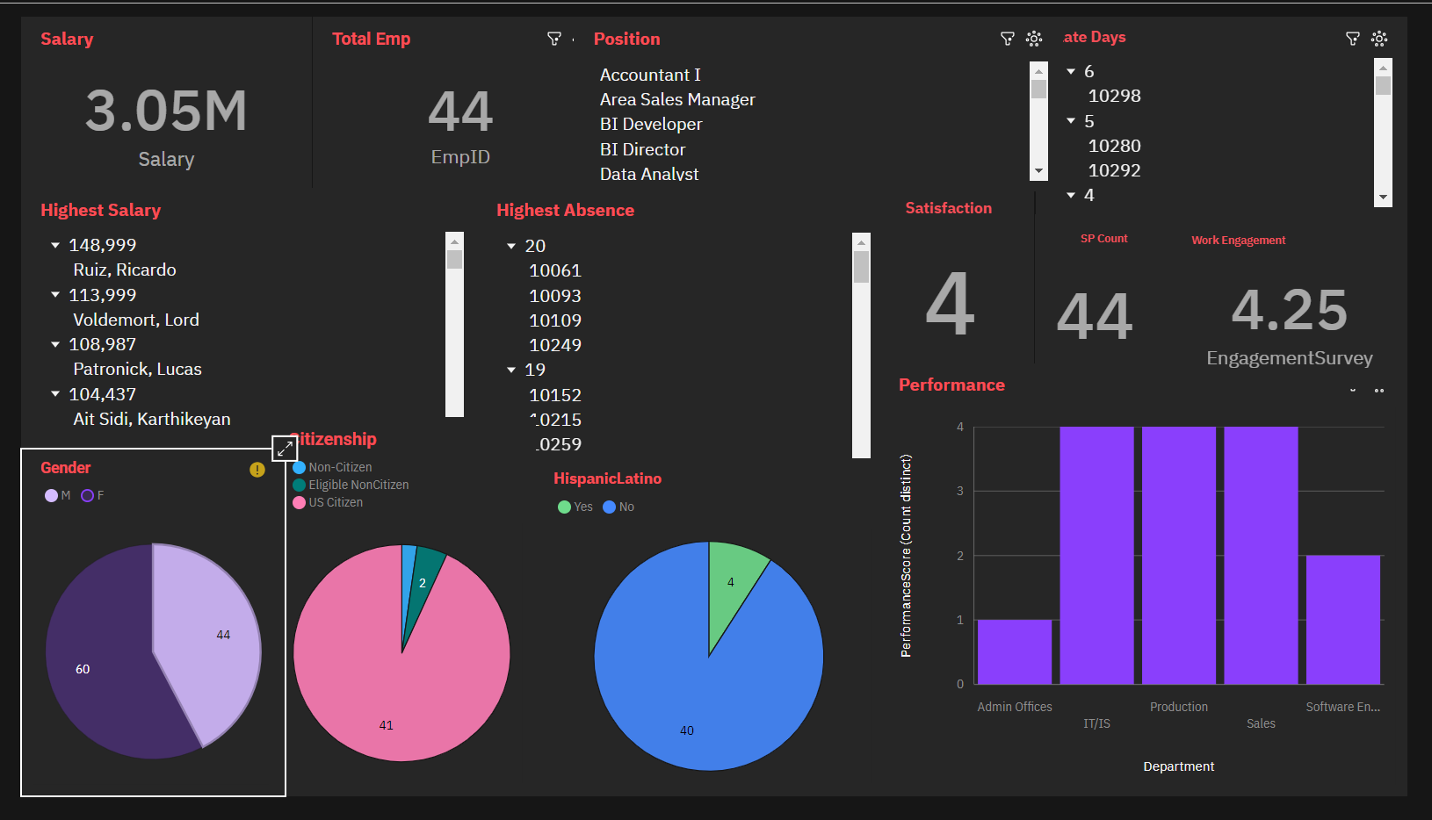
Female Employees
Male Employees

Slide 3
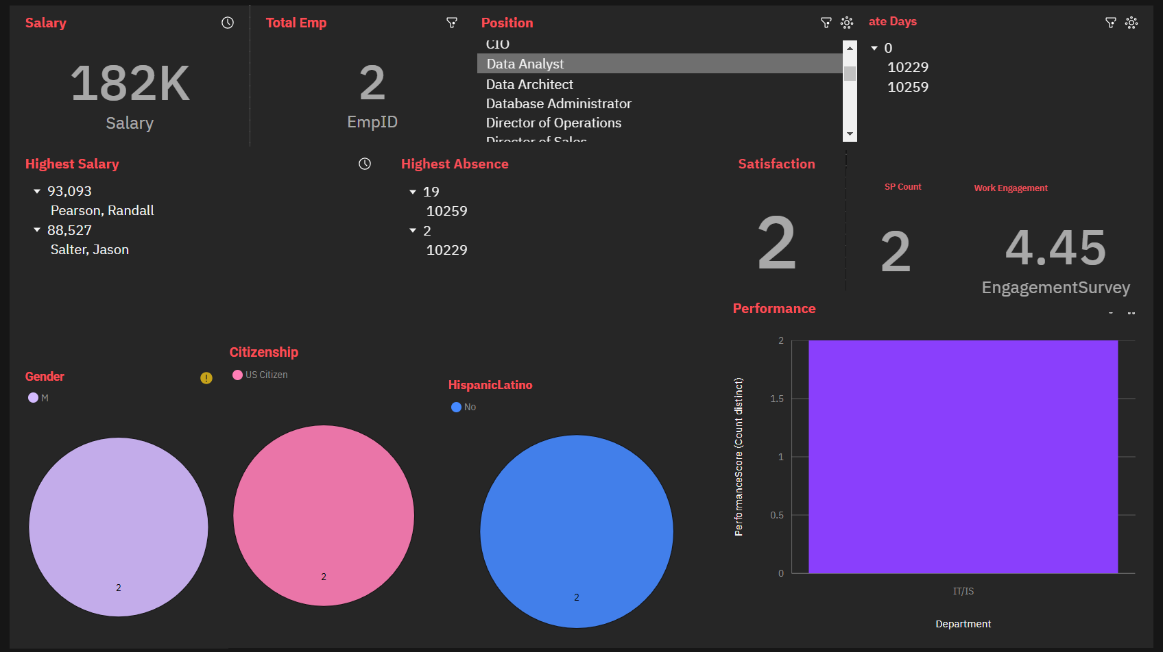
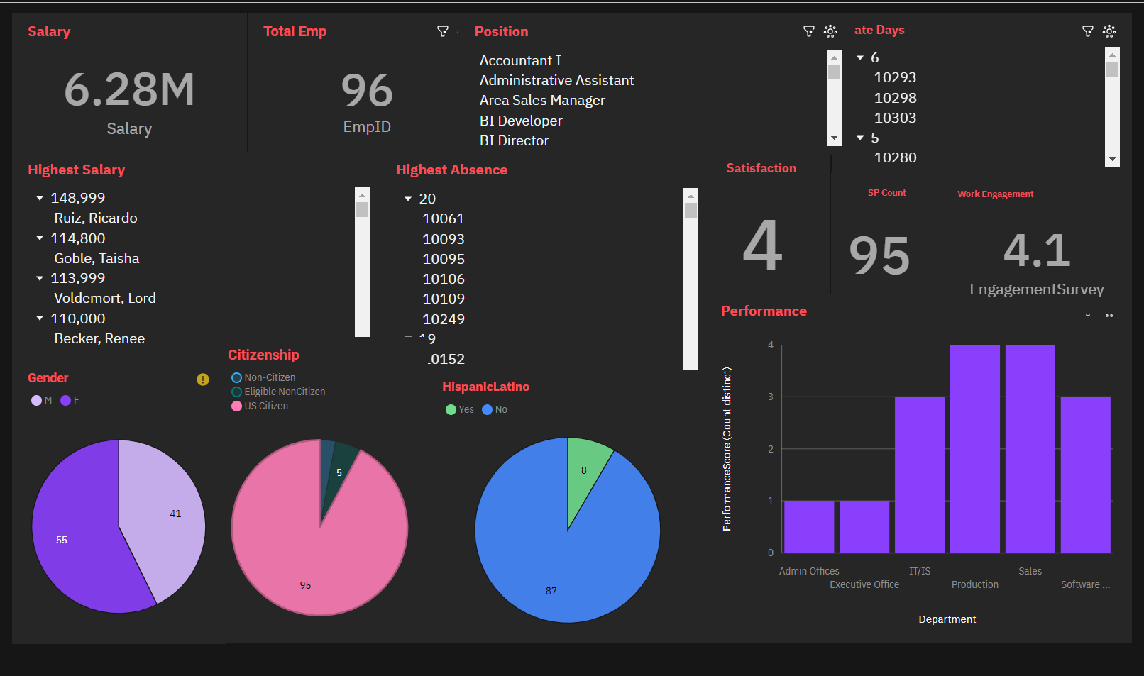
Data Analyst Employee
US Citizen Employees

Slide 4
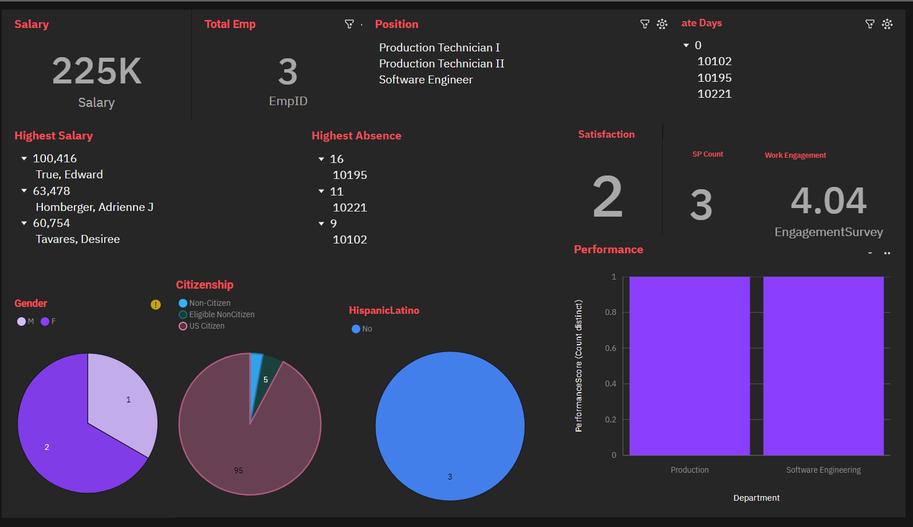
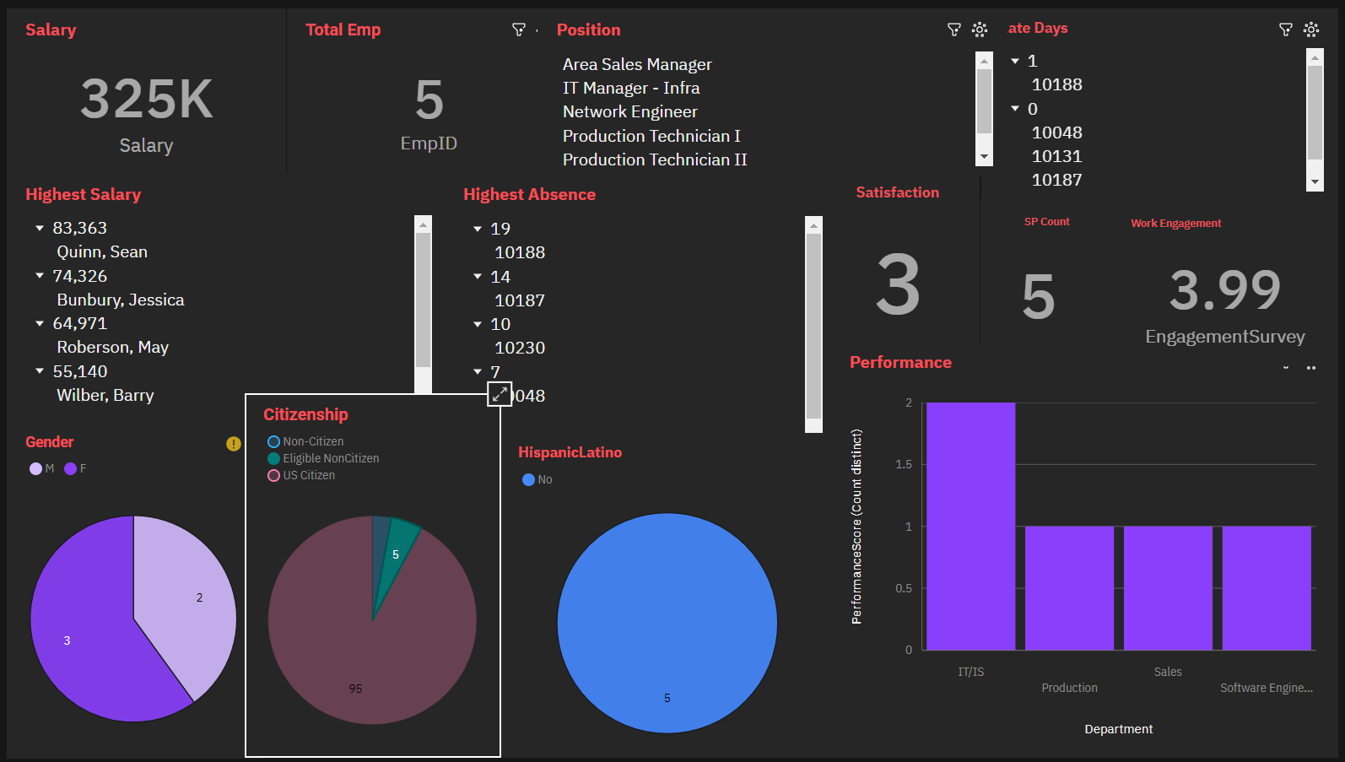
Non Citizen Employees
Eligible Non Citizen Employees

Slide 5
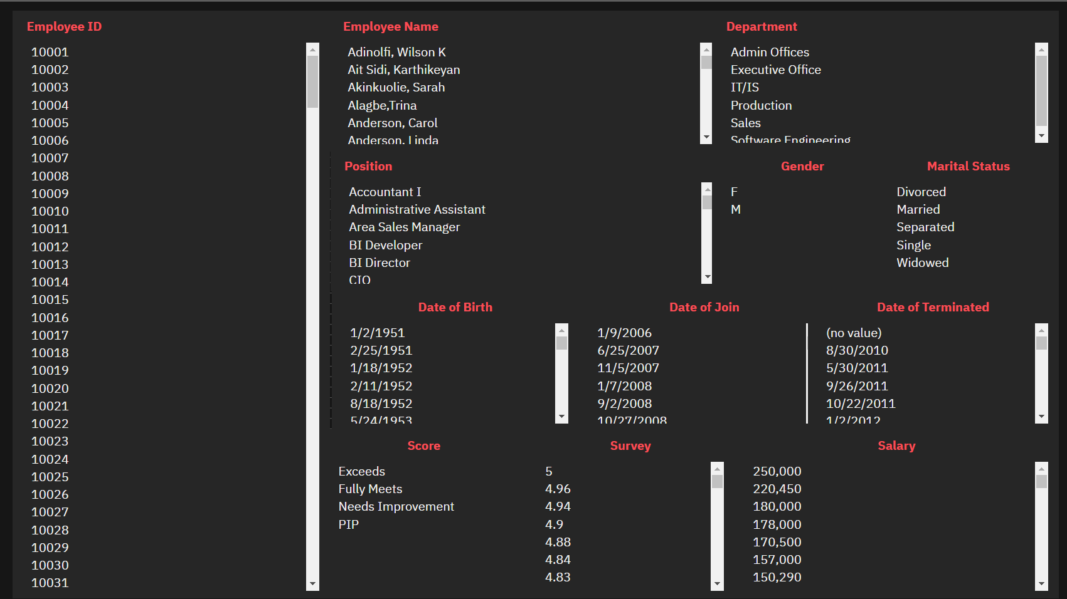
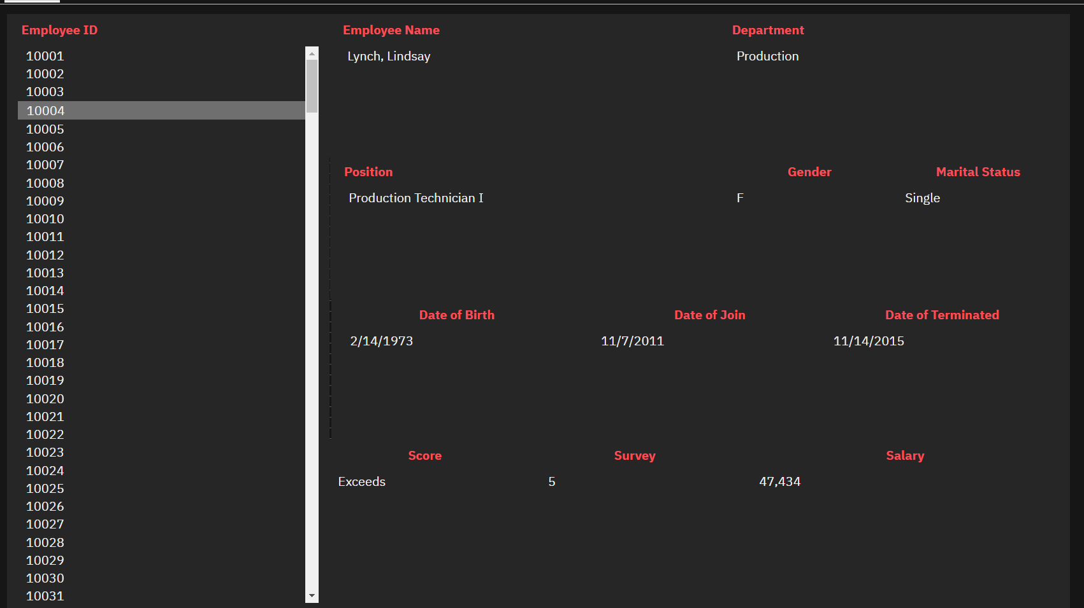
Search Dashboard
Search with Employee ID

Slide 6
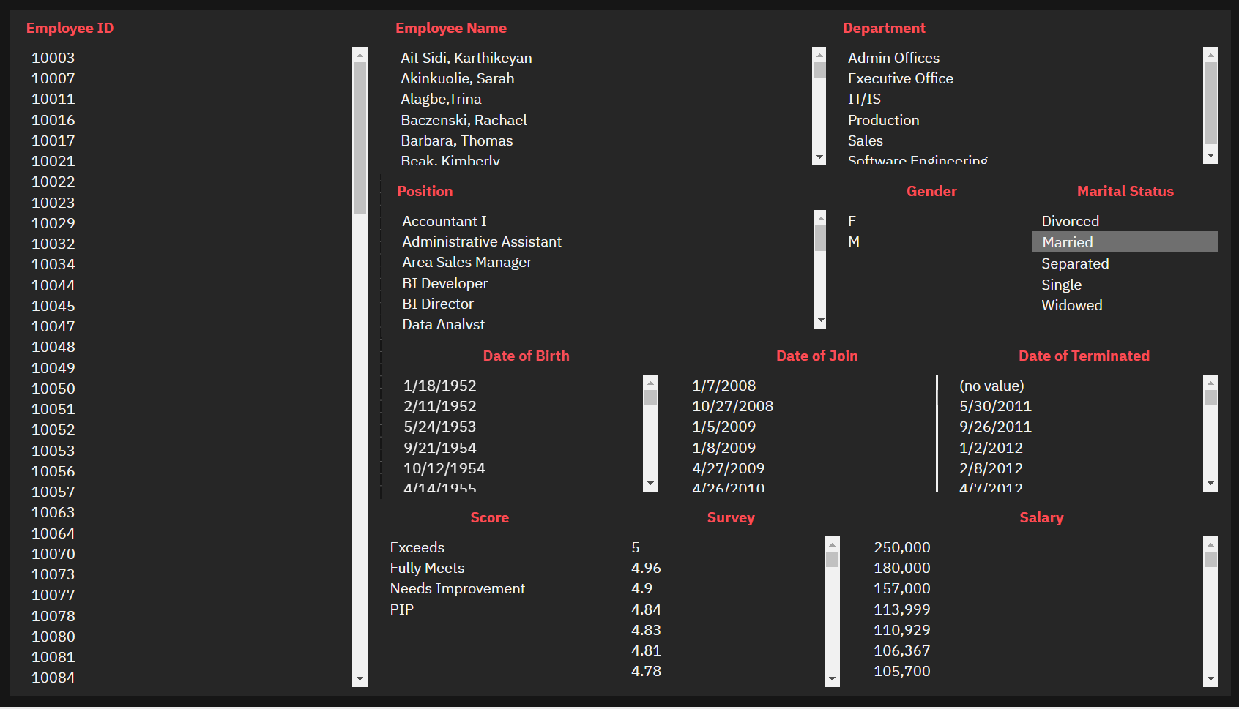
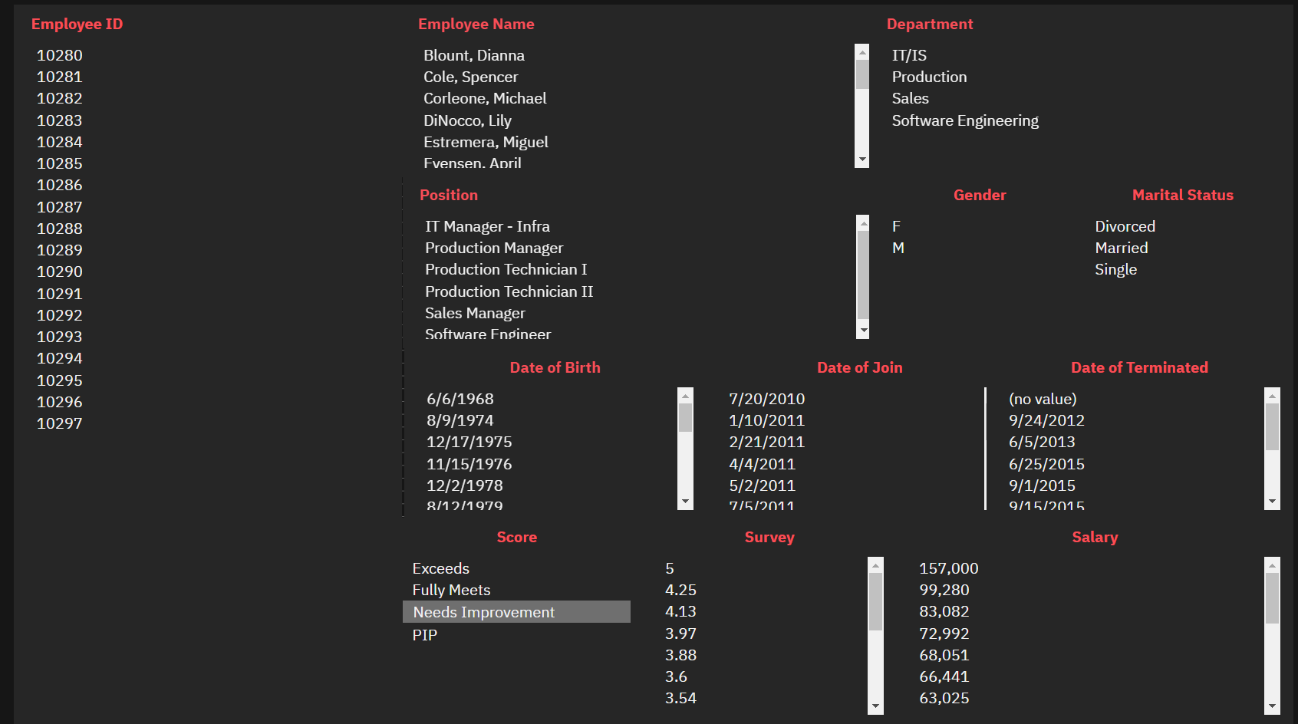
Search with Marital Status
Search with Performance Score

Slide 7
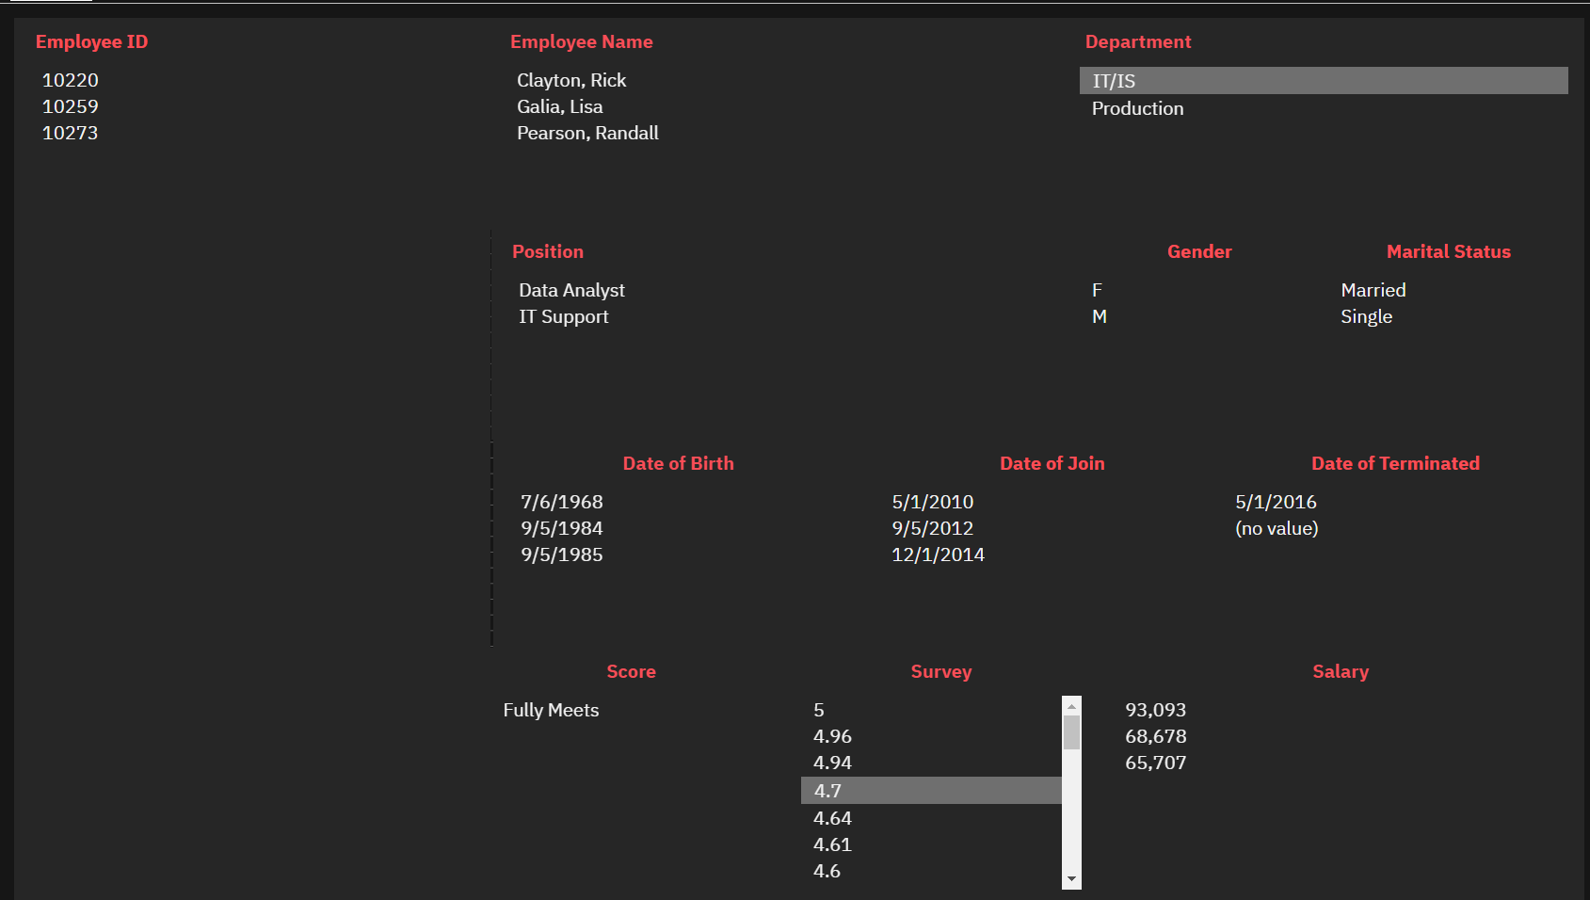
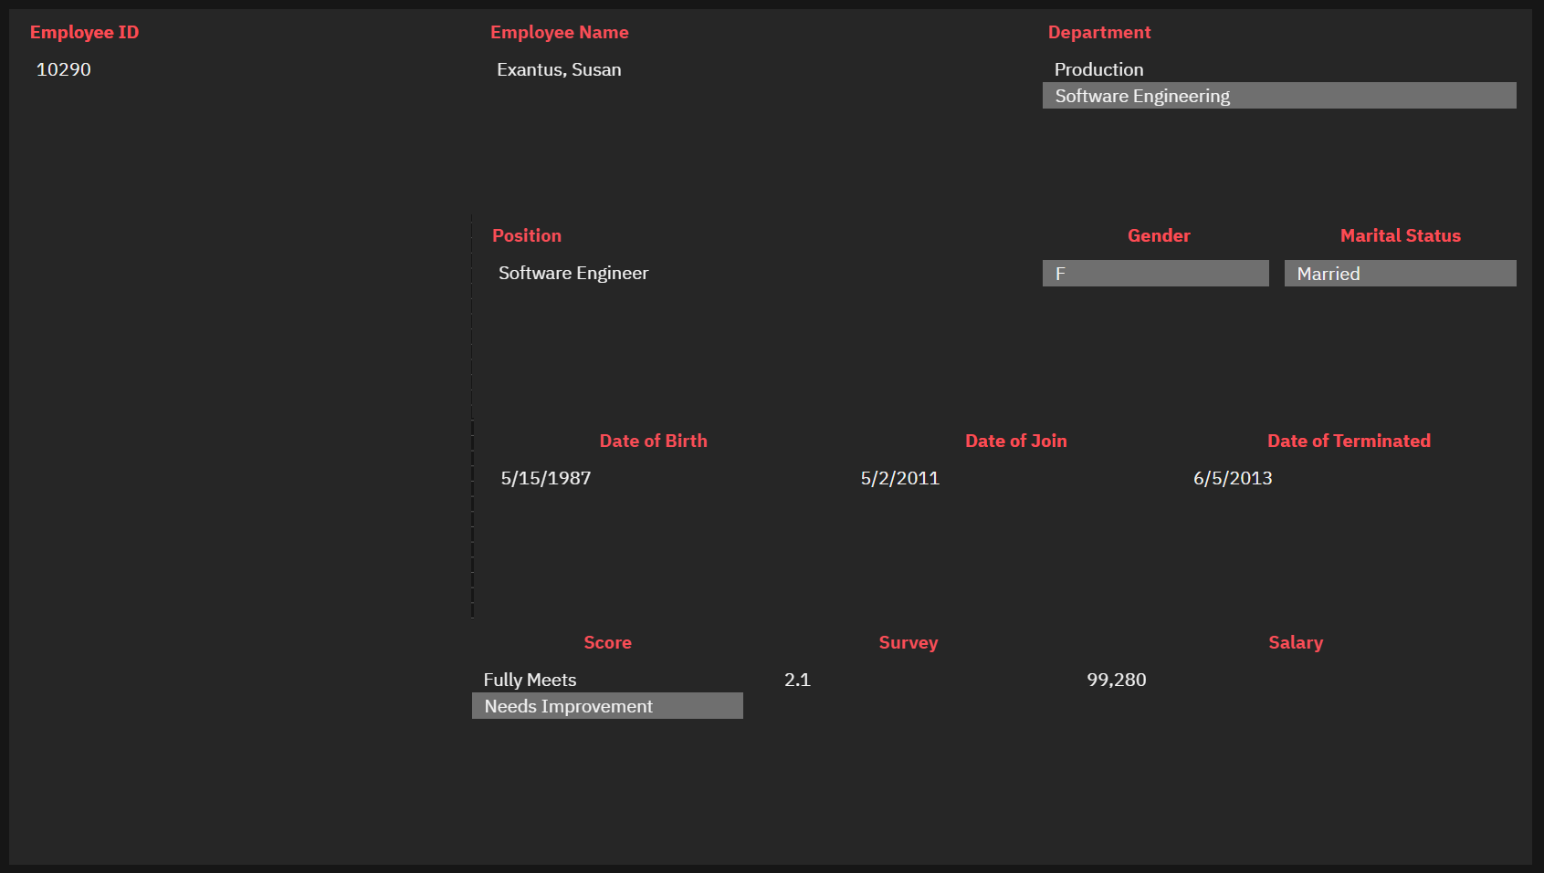
Search with Survey Performance and Department
Search with Multiple Attributes

